Slide 1
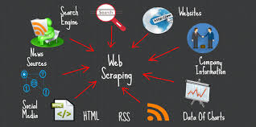
web scraper
using python
NAME :
A. BHARATH KUMAR (192211985)
P. VENKATA SHASIDHA (192210650)
SK.SALMAN (192211984)
GUIDED BY: DR.E.K.SUBRAMANIAN,
ASSOCIATE PROFESSOR,
DEPARTMRNT OF PROGRAMMING,CSE
SSE,SIMATS

Slide 2

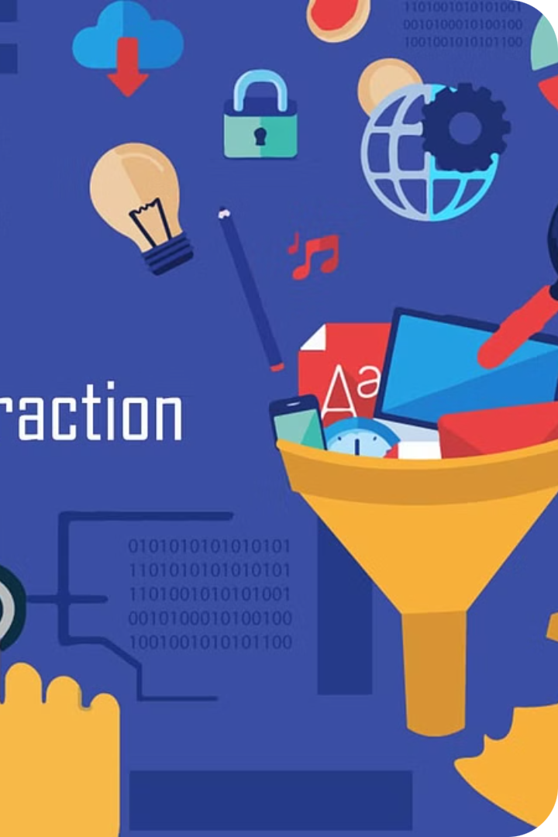
Introduction to Web Scraping
Web scraping is the process of extracting data from websites using automated software. It allows you to gather large amounts of information from the internet, unlocking valuable insights hidden within the data.

Slide 3
Types of Web Scraping
Manual Scraping
1
Manually copying and pasting data from websites
Automated Scraping
2
Using scripts or software to extract data automatically
API-based Scraping
3
Accessing data through a website's official API
Web scraping can take various forms, from simple manual copying and pasting to sophisticated automated scripts. API-based scraping provides a more structured and reliable approach by accessing data through a website's official channels. The choice of method depends on the complexity of the task and the website's data access policies.

Slide 4


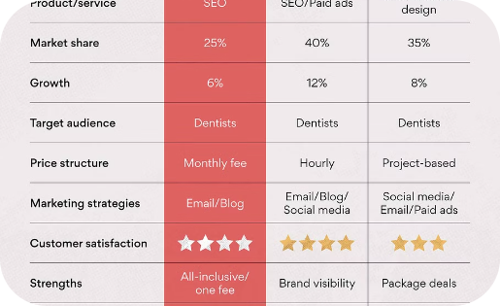
Advantages of Web Scraping
Efficient Data Gathering
Access to Real-Time Data
Competitive Insights
Web scraping automates the process of extracting large datasets from websites, saving time and resources compared to manual data entry.
Scraped data can be continuously updated, providing businesses with the latest information to make informed decisions.
Web scraping allows companies to monitor their competitors' pricing, product offerings, and marketing strategies, helping them stay ahead of the curve.

Slide 5
Challenges and Limitations
Legal Compliance
Technical Complexity
Web scraping may raise legal concerns around data privacy and copyright infringement. Adhering to terms of service and obtaining necessary permissions is crucial.
Scraping dynamic websites with JavaScript-heavy content or CAPTCHA protection can be technically challenging, requiring advanced programming skills.
Reliability Issues
Ethical Considerations
Web scraping is susceptible to website changes, server downtimes, and network errors, which can disrupt data collection and lead to incomplete or inaccurate results.
Excessive or aggressive scraping may be seen as a form of denial-of-service attack, potentially harming the target website and its users. Responsible practices are essential.

Slide 6
Future Scope of Web Scraping
1
Advancements in AI and Machine Learning
2
Real-Time Data Monitoring
Web scraping will play a crucial role in monitoring real-time data, such as stock prices, social media trends, and news updates, empowering businesses to make informed, data-driven decisions.
As AI and machine learning technologies continue to evolve, web scraping will become more sophisticated, enabling automated data extraction, analysis, and decision-making at scale.
3
Ethical and Responsible Practices
4
Personalized Web Experiences
With growing concerns about privacy and data rights, the future of web scraping will likely involve the development of more ethical and responsible practices, ensuring data is collected and used responsibly.
Web scraping will enable the creation of more personalized web experiences, as businesses leverage data to tailor content, products, and services to individual user preferences.

Slide 7





How to Run a Web Scraper in the Command Prompt
1. Install Python
1
Ensure you have Python installed on your machine.
2
2. Install Scraping Library
Use pip to install a web scraping library like BeautifulSoup or Scrapy.
3
3. Write Scraping Code
Create a Python script that defines your scraping logic.
4
4. Run in Command Prompt
Open the command prompt and execute your Python script.
5
5. Collect Data
The scraper will extract and save the desired data.
Running a web scraper in the command prompt involves installing Python, setting up a web scraping library, writing the scraping code, and executing the script in the command prompt. This allows you to easily automate data extraction from websites without the need for a graphical user interface.

Slide 8
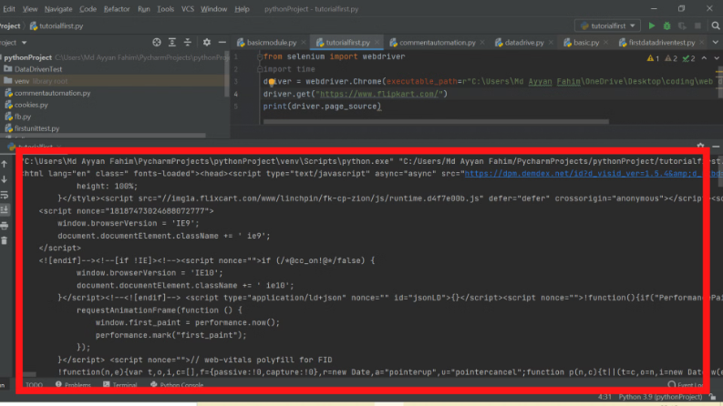
Source Code and Output
Showcasing the actual source code and output is a crucial step in any web scraping presentation. This section should provide a clear and concise demonstration of the web scraper in action, highlighting the key features and functionality.
By sharing the source code, you can illustrate the technical implementation details, while the output will demonstrate the real-world application and the value of the web scraping process.

Slide 9
Popular Web Scraping Libraries
Python Libraries
JavaScript Libraries
BeautifulSoup - A popular library for parsing HTML and XML documents. It provides a simple way to extract data from webpages.
Puppeteer - A Node.js library that provides a high-level API to control headless Chrome or Chromium.
Cheerio - A jQuery-like library for parsing and manipulating HTML documents in Node.js.
Scrapy - A high-level web scraping framework that allows you to write efficient and reusable scrapers.
Nightmare - A high-level browser automation library for Node.js that can be used for web scraping.
Selenium - A powerful library for automating web browsers, which can be useful for scraping dynamic websites.

Slide 10



Best Practices for Web Scraping
Respect Robots.txt
Throttle Requests
Mimic User Behavior
Always respect the website's robots.txt file, which specifies how web crawlers should interact with the site.
Avoid overloading the target website by throttling your requests and introducing delays between them.
Set proper user-agent headers and simulate typical user interactions to avoid detection by anti-scraping measures.

Slide 11
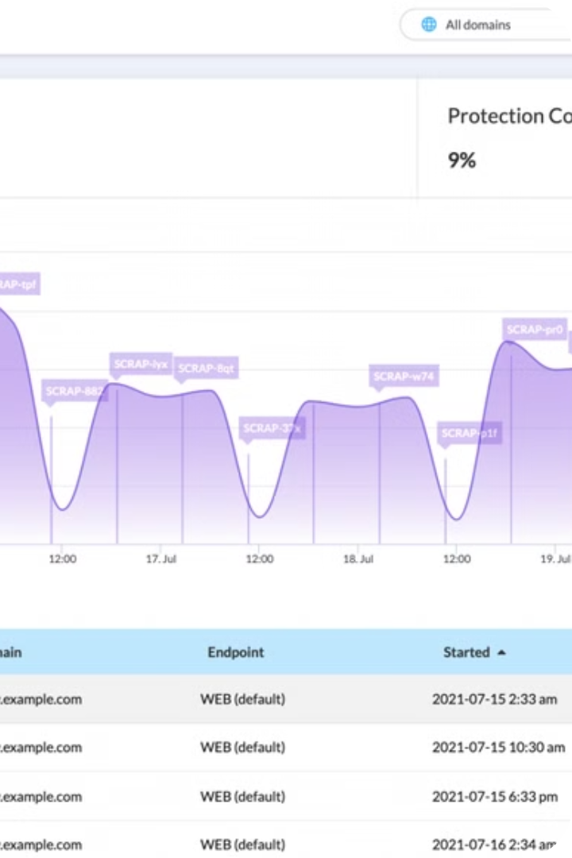
Conclusion and Key Takeaways
In conclusion, web scraping is a powerful tool for extracting valuable data from websites. By leveraging the right techniques and libraries, businesses and researchers can gain insights, automate tasks, and make data-driven decisions. As the demand for data grows, the future of web scraping looks promising, with emerging technologies and best practices continuing to evolve.

